Slide 1

TRIO USE by ERRORs (consists of Manojkumar.K and Mohammed Rashid.A)

Slide 2
PROJECT NAME : TRIO USE by ERRORs (consists of Manojkumar.K and Mohammed Rashid.A)
For your kind informtion ERRORs is our team name .
TOOLS : we have used news , joke and weather APIs and python programming language to build this project .
USES : You can get the current top news in BBC , you can get a funny joke (not actually) and the current weather of any city in the world

Slide 3
DIFFICULTIES : At the begining we messed up with the api and finnaly found out these .
Especially we can't joke api which gives a joke , all the joke api gives a sentence and names it as joke .
After going through lot of dippression in joke api we finnally finished the project .
But not actually finished , we have planned to create a web app but due to lack of time we finished using python .
FURTHER PLANS : To create a web version of it .

Slide 4
DISCLIMERS : This documentation may (not compulsarily) have some spelling mistakes so forgive us for that .
For non-coders API means
API is the acronym for Application Programming Interface, which is a software intermediary that allows two applications to talk to each other.
Each time you use an app like Facebook, send an instant message, or check the weather on your phone, you're using an API.
The joke generated by the joke generator might not look like a joke but it is actally a joke please beleive me .

Slide 5
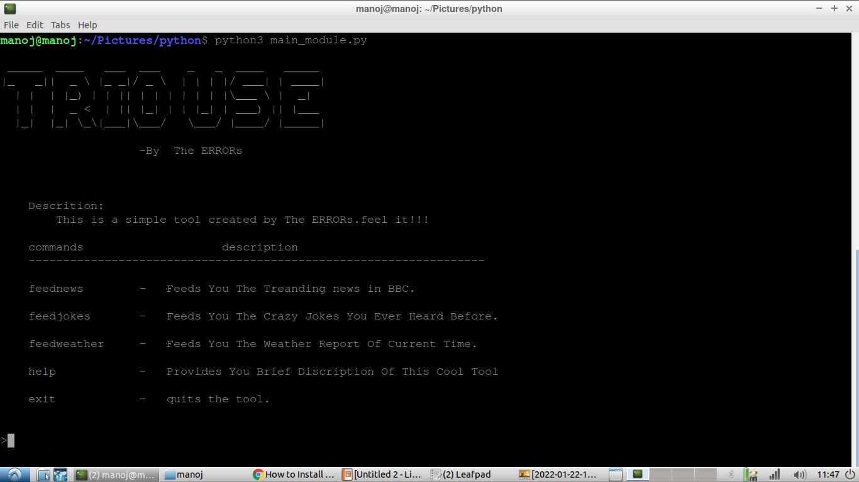

Slide 6
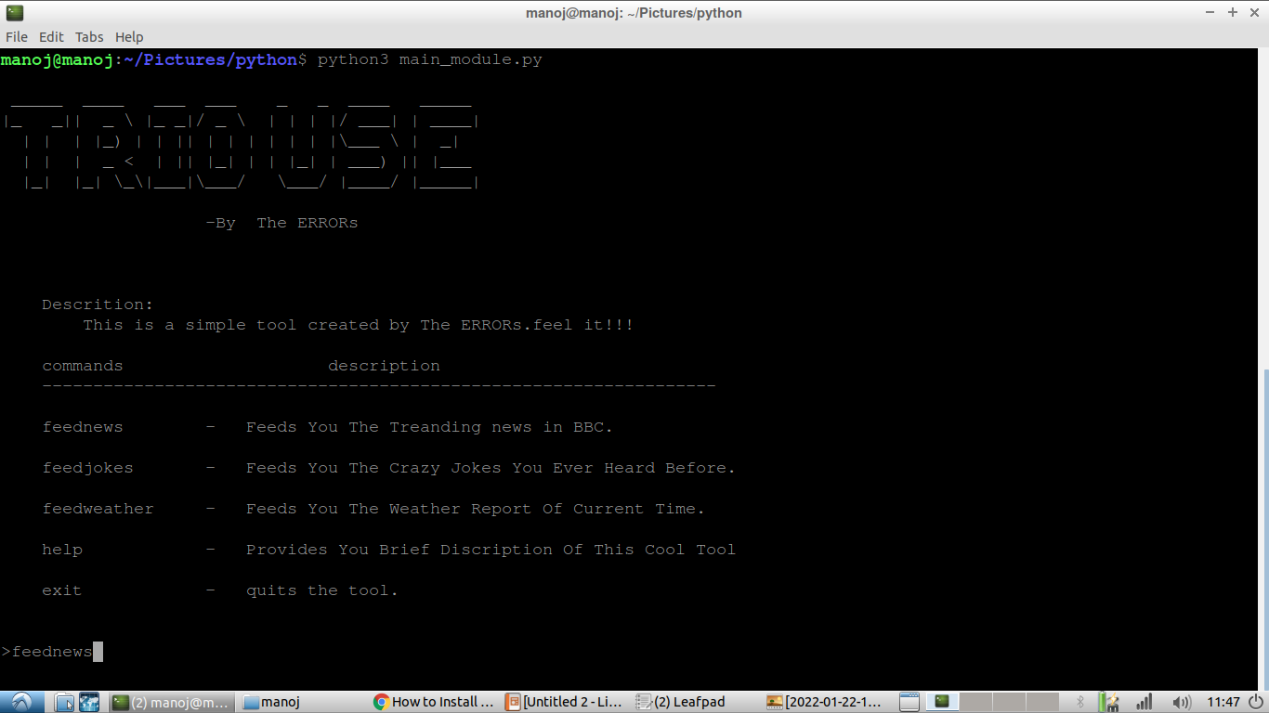

Slide 7
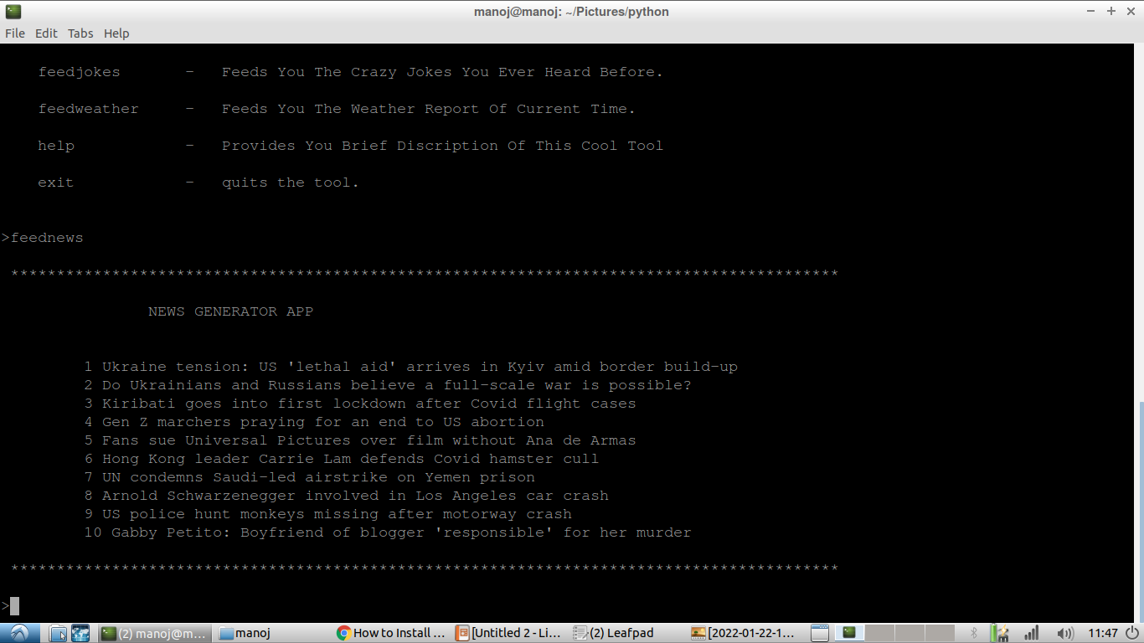

Slide 8
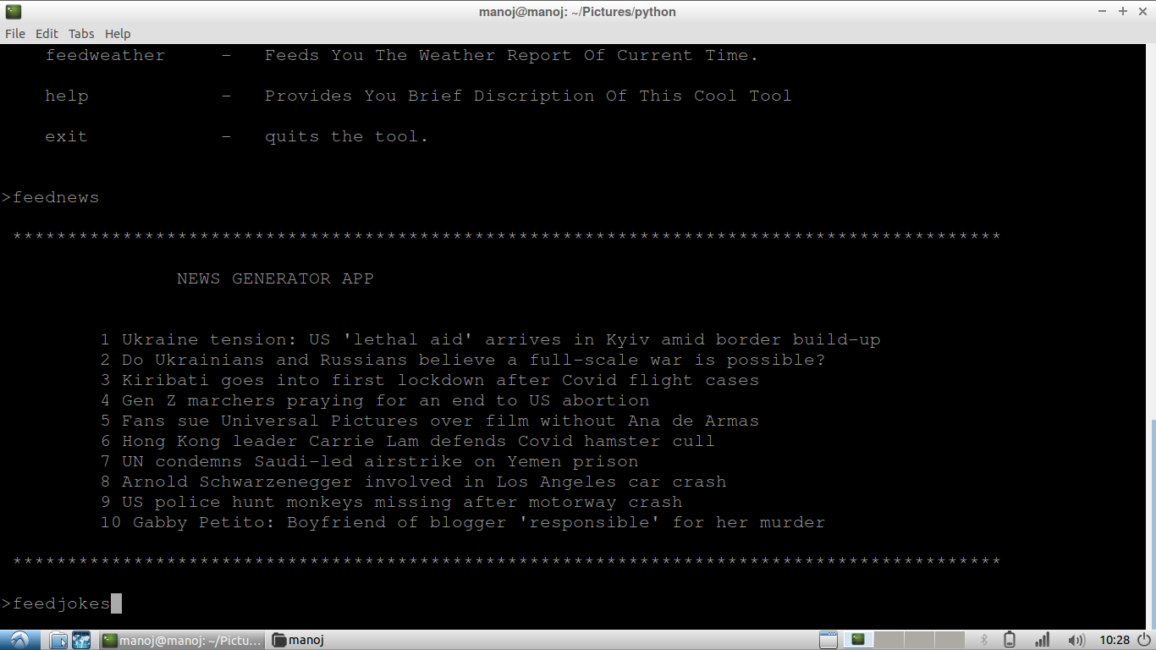

Slide 9
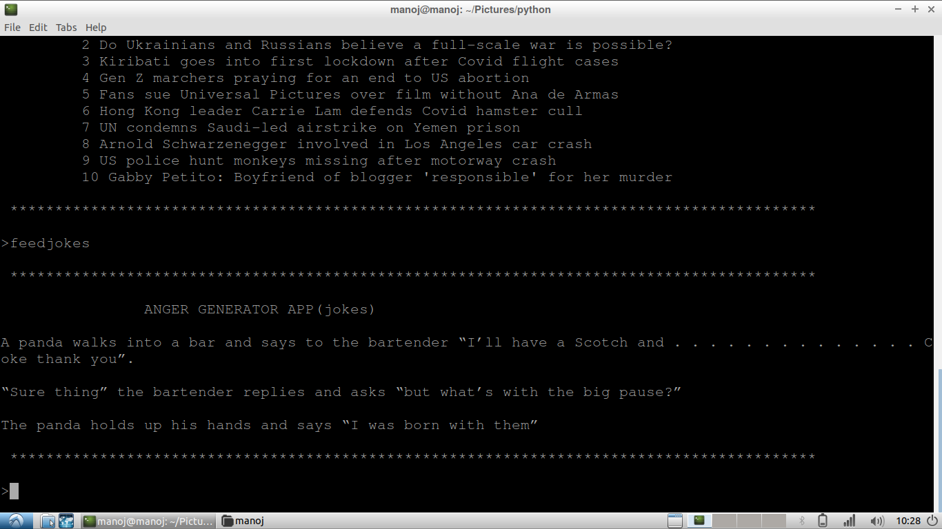

Slide 10
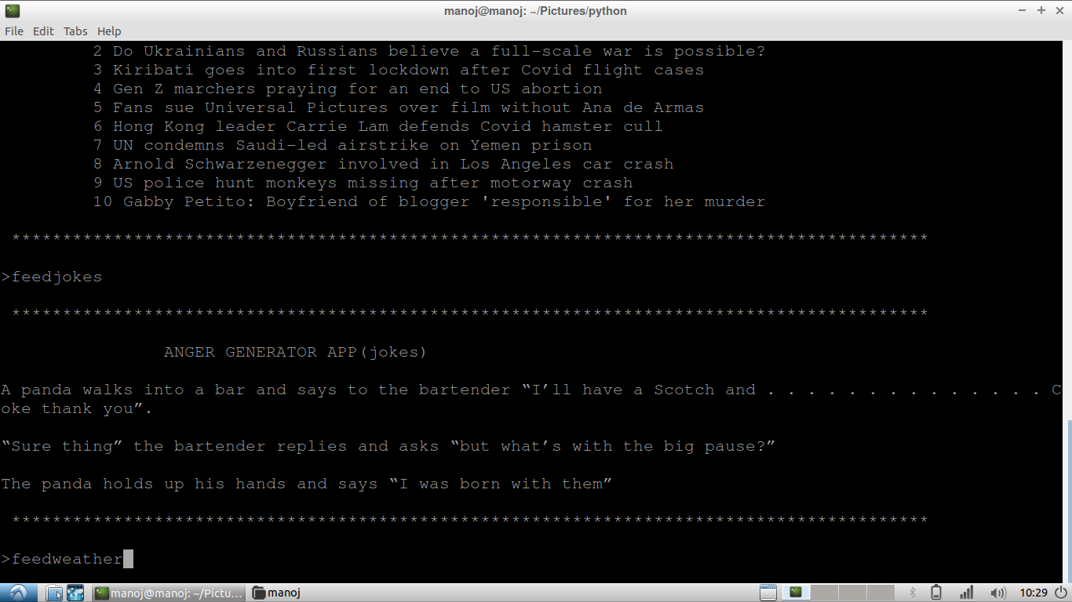

Slide 11
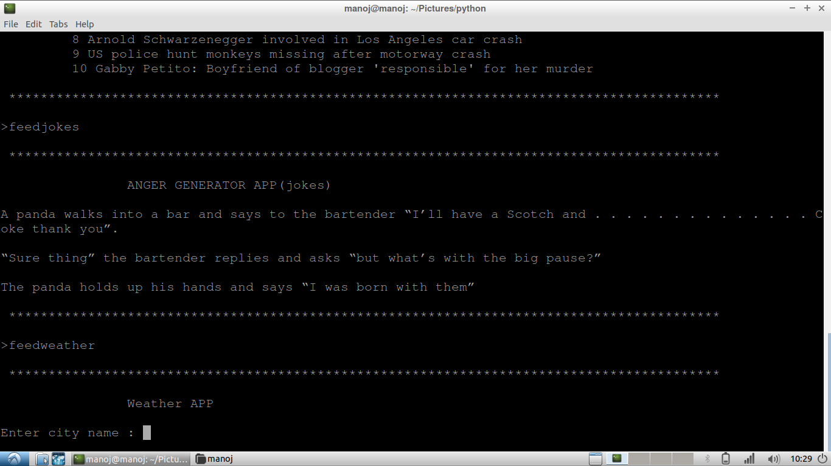

Slide 12
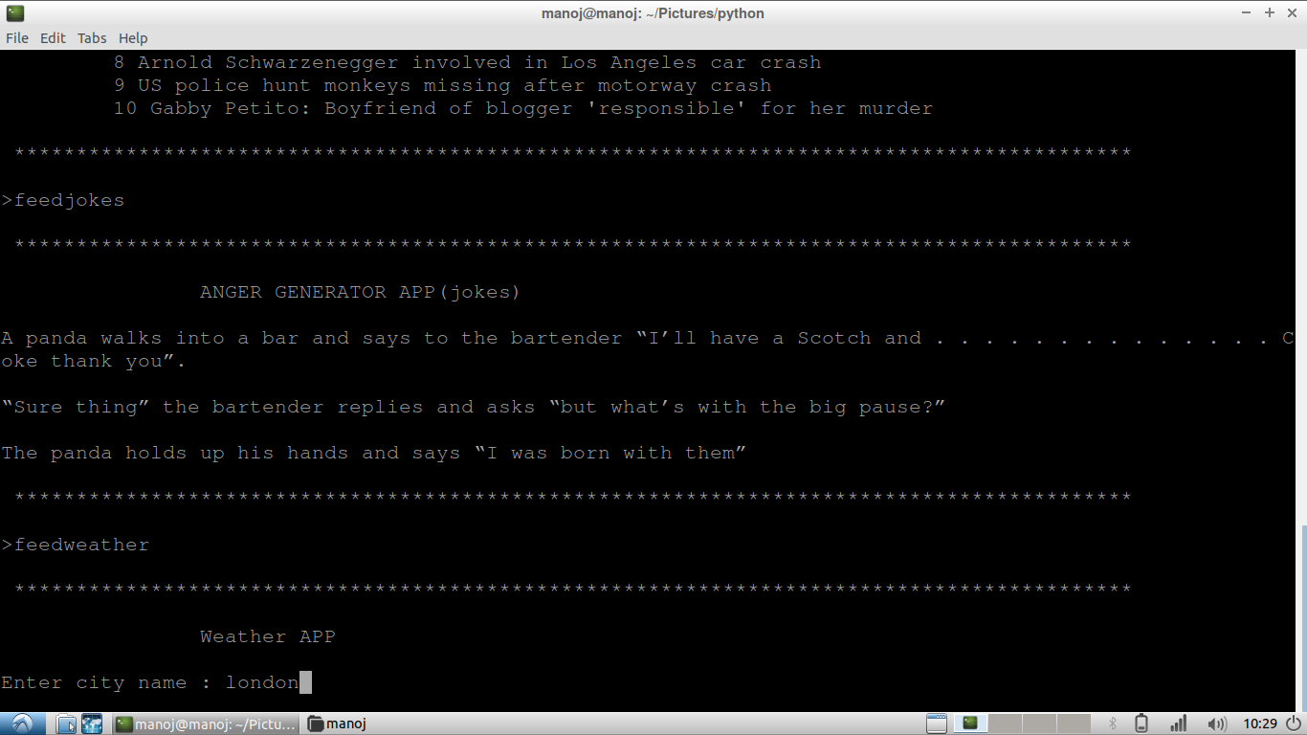

Slide 14
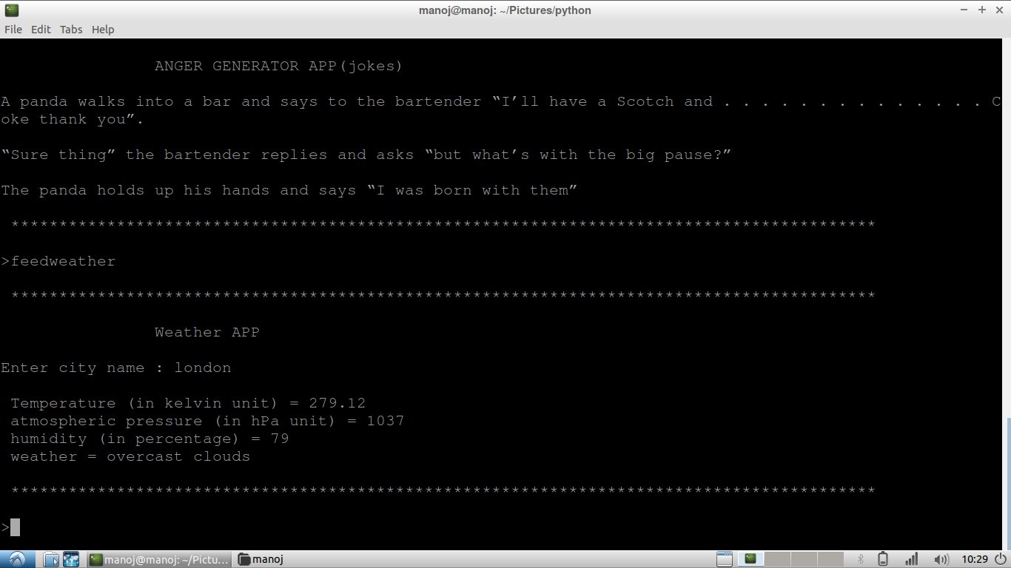

Slide 15


Slide 16
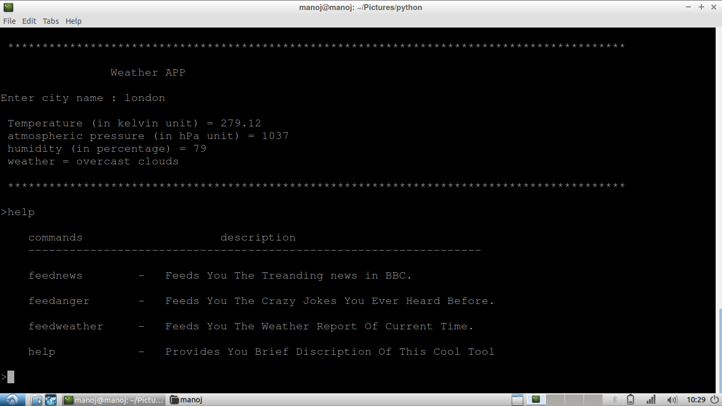

Slide 17


Slide 18
